Slide 1
Probability & Statistics
Correlation and Regression
Ben Baumer

Slide 2
Content
Visualizing Two Variables
Correlation
Simple Linear Regression
Interpreting Regression Models
Model Fit

Slide 3
Visualizing Two Variables
We will learn techniques for characterizing and quantifying the relationship between two numeric variables (i.e. bivariate relationships)
Output response; dependent variable; y
Input something you think might be related to the response; independent variable; explanatory variable; predictor, x
A scatterplot is the most useful way to visualize the response (y-axis) versus the predictor (x-axis).
Its helpful to think of a scatterplot as a generalization of a side-by-side boxplot of the discretized explanatory variable.
Applied R (Scatterplots and Boxplot)
ggplot(data = possum, aes(y = total, x = tail)) +
geom_point() +
scale_x_continuous(“Length of Possum Tail (cm)”) +
scale_y_continuous(“Length of Possum Body (cm)”)
ggplot(data = bdims, aes(y = wgt, x = hgt, color = factor(sex))) +
geom_point(alpha = 0.5, position = “jitter”)
ggplot(data = possum, aes(y = total, x = cut(tail, breaks = 5))) +
geom_boxplot()
ggplot(data = mammals aes(y = BrainWt, x = BodyWt)) +
geom_point() +
coord_trans(x = “log10”, y = “log10”)
ggplot(data = mammals aes(y = BrainWt, x = BodyWt)) +
geom_point() +
scale_x_log10() +
scale_y_log10()
ways to deal with overplotting
There are four characteristics of bivariate relationships that we want to observe:
Form linear, quadratic, non-linear, etc...
Direction positive (same direction), negative (opposite direction)
Strength how much scatter or noise; quantified by the correlation coefficient
Outliers it is important to understand how the relationship changes when outliers are excluded
transforming the axis scaling can change your outlook on the form of the relationship
Pearson product-moment correlation

Slide 4
Correlation
Applied R (Calculating Correlation)
ncbirths %>%
summarise(obs = n(),
r = cor(weight, mage, use = “pairwise.complete.obs”))
correlation is symmetric – that is, the order of the variables does not matter
used to deal with NAs in the data
The Anscombe dataset demonstrates why visualizing the dataset is critically important in conjuction with calculating statistics on the dataset.
Statisticians have shown that people’s perception of the strength of a relationship can be influenced by design choices like the x and y axis.
Its helpful to think of a scatterplot as a generalization of a side-by-side boxplot of the discretized explanatory variable.
Remember: correlation suggests the presence or lack of association in a bivariate relationship, it does NOT imply causation.
Remarkable but non-sensical correlation is referred to as spurious correlation. Confounders are usually the culprit that leads to spurious correlation. Time and Space (geography) are classic confounding variables. Random noise can all lead to patterns with spurious correlation.
Applied R (Spurious Correlation)
ggplot(noise, aes(x, y)) + geom_point() + facet_warp(~z)
noise_summary <- noise %>% group_by(z) %>% summarise(N = n(), r = cor(x, y))
noise_summary %>% filter(abs(r) > 0.2)
noise is a dataset containing 20 sets of 50 observations of x and y variables drawn at random from a standard normal distribution
you’ll always find non-trivial correlation, however, none of the 20 sets have observations with any causal link – this is a great demonstration of spurious correlation

Slide 5
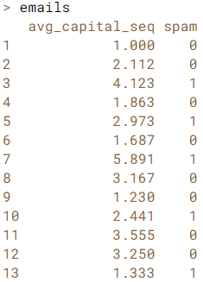
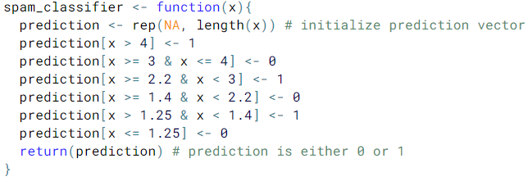

Classification
Classification MLP attempt to predict the category of a new observation.
Earlier Observations are used to estimate a Classifier
The classifier is then used to label a new observation with a Class
Classes are qualitative and predefined
Applied R (Classification: Filter Spam)
In this example the training data (emails) is used to develop the Classifier. However this is not a valid approach in an actual classification MLP.
Classifier
feature vector
label on observed data
Class predictions from our Classifier

Slide 6
Regression
Regression MLP attempt to estimate a Response value after a set of Predictors are pushed through a Regression Function.
In linear regression, the regression function is estimated by two paramaters β₀ and β₁
Applied R (Studying Information)

Slide 7
Clustering
Clustering MLP attempt to group similar objects in clusters while ensuring that each cluster is dissimilar from every other cluster.
Clustering is similar to classification MLP however the important distinction is that in clustering, the classes, or clusters, are not predefined.
Applied R (Studying Information)

